Slide 1
The Power of Small Groups in Youth Ministry
Children’s & Youth Church Training
January 21, 2018

Slide 2
What is a Small Group?
Simple Definition
A micro-community of 3-12 Jesus followers (ekklesia) doing the Christian life together.

Slide 3
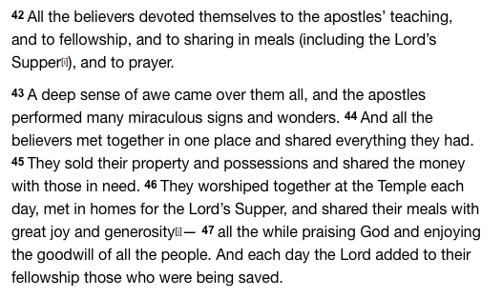
Consider the First Believers in Acts 2:42-47(NLT)

Slide 4
Ways They Did the Christian Life Together
Devotion to living out what they learned from studying God’s word together (the apostles’ teaching)
Devotion to doing life together (fellowship)
Eating together and partaking of the Lord’s Supper together (the sharing in meals)
Devotion to a lifestyle of prayer
Meeting one another’s needs even when it meant giving up something substantial of their own (sold property and shared money with those in need)
Devotion to frequent worship together (they worshipped at the temple daily)

Slide 5
The Result
Consider Acts 2:47
The Lord added to their fellowship those who were being saved.

Slide 6
4 Categories of Small Groups in Ministry Settings
Theological
Relational
Restorative
Mission Minded

Slide 7
Benefits of Small Groups in Youth Ministry

Slide 8
1. During Biblical explorations, the youth get to understand about God’s character and His expectations.
Notes:
-Youth have so many questions about God and his nature. Small group settings allow group leaders the opportunity to breakdown complexities that youth have about knowing who God is.
This is an opportunity for the Bible to speak to the activities and actions of the group as whole.
-

Slide 9
2. There’s a sense of relational interdependency developed among all members of the group.
Notes:
As groups meet and share more frequently, relationships are being developed and trust is being established.
Members of the group, both students and leaders, develop the “I Need You and You Need Me to Survive” mentality. It shifts the focus of the youth from a “I don’t need anyone” type of mentality.
It connects students with youth leaders or mentors.
It also challenges the group leaders to be committed to the cause of serving because of the relational needs of the youth. Really, there is a much larger need beyond the relational aspect but this is where it starts.
Meaningful friendship are also developed among peers.

Slide 10
3. Small Groups create a non-threatening atmosphere for healing and restoration.
Notes:
Through the power of the Holy Ghost and the truth of God’s word, small groups open the door for more intimate conversations and transparent conversations among the youth.
-In these environments, we will see the restorative healing of God’s word in greater effect because small groups focus on the real heart of the matter in a judgement free zone.

Slide 11
4. Small groups prepare youth for personal ministry.
Notes:
Youth leaders are birthed out small groups.
They get to authentically shared their faith with faith and participate and lead group discussions. Ultimately, this challenges youth to develop their relationship with God.
As the the grow spiritually in these intimate environment, we see overall exponential growth because they don’t mind sharing what God did for them.

Slide 12
Challenges With Small Groups in Youth Ministry
Learning to Deal with Different Personalities
The Over Talker
The Non-Talker
The Tangent-Starter
The Insensitive Kid
Notes:
Remember the end goal is LIFE-CHANGING discussions, not perfect discussions or getting through the material.
God is the one who does the work in People’s hearts…we just creating the environment for it to happen.

Slide 13
Next Week….
Developmental Stages of Youth
Group Assignment
Let’s Develop an Ideal Children’s (5-12)/Teen (13-18) Church Program
Consider Target Audience (Age Appropriate Content)
Marketing Structure
The Setting (What Does the Environment Look Like)
The Flow (From Start to Finish)
Be Creative and Be God-Focused
Engage Youth in Planning (Ask Them)

